Slide 1
ACC3018 Applied Analytics Capstone Seminar 4

Slide 2
Agenda
Databases
R programming: cleaning and merging data
Sentiment Analysis
Endogeneity
Case 1: effect of GDP on global life expectancy
Instrumental Variable & Two-Stage Least-Squares Regression
Case 2: effect of cigarette price on cigarette consumption
Case 3: effect of schooling on earnings in a classical model for wage determination

Slide 3
Databases
Financial and ESG data: WRDS https://wrds-www.wharton.upenn.edu/
World bank: https://data.worldbank.org/
Singapore Data: https://www.singstat.gov.sg/
Property Data: https://www.ura.gov.sg/Corporate/Property/Property-Data
Bloomberg

Slide 4

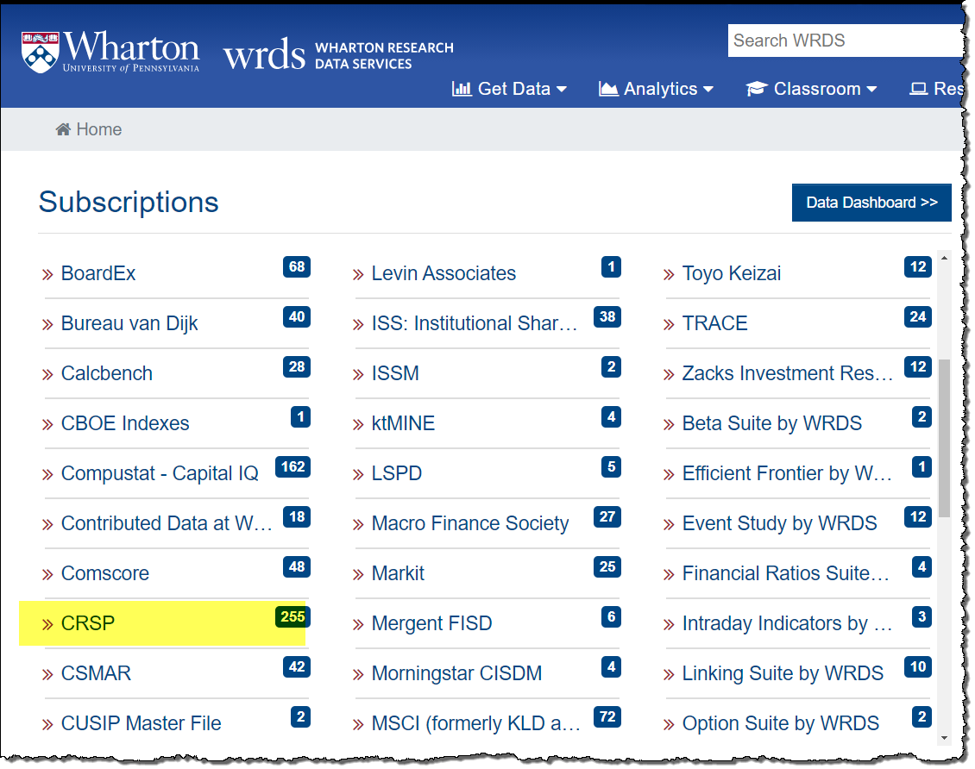
WRDS Home Page
The WRDS Home page displays your data subscriptions.
Scroll down the page to locate the CRSP dataset.
Click on CRSP.

Slide 5
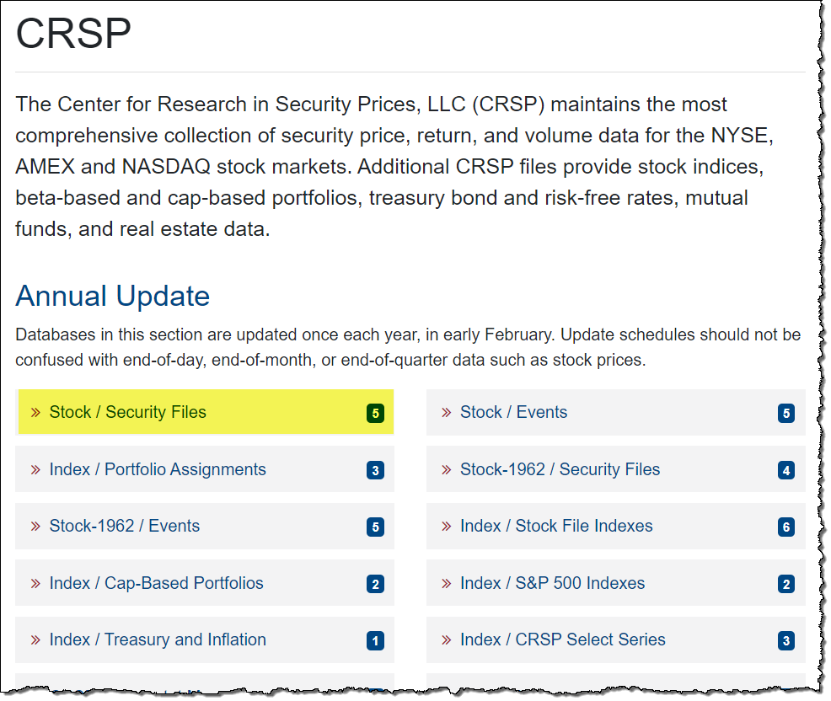
CRSP Page
Click on Stock/Security Files.

Slide 6
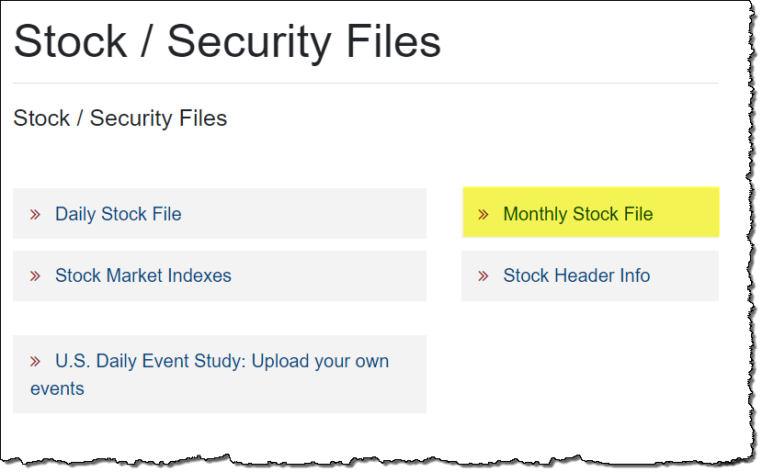
CRSP Stock/Security Files Page
Click on Monthly Stock File.

Slide 7
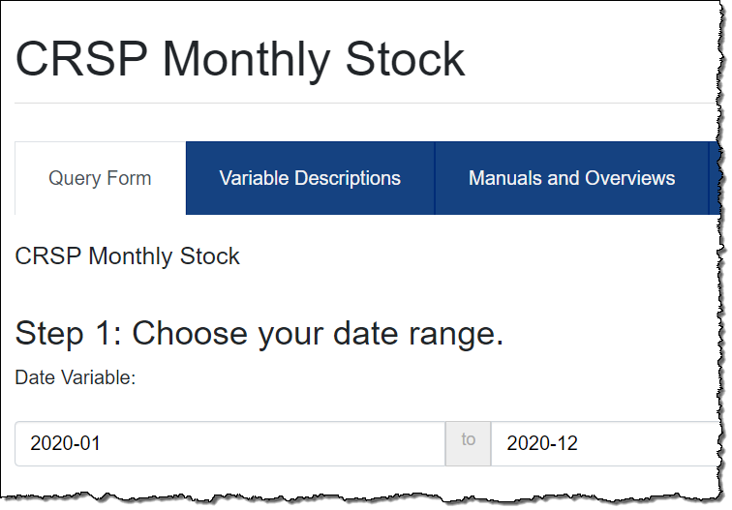
CRSP Monthly Stock Data Query
On the query page, the first step is to select the date range for your data.
Enter 2020-01 to 2020-12 in the Date Variable fields.

Slide 8
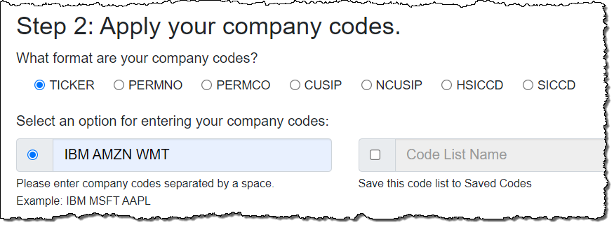
Enter the Companies
Make sure Ticker is selected.
Enter the ticker symbols for the companies: IBM AMZN WMT.

Slide 9
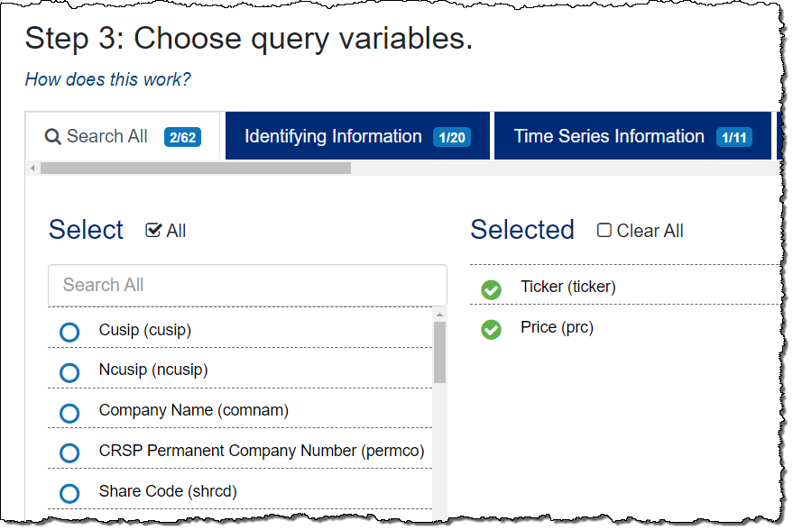
Select the Query Variables
Select the variables you want from the Query Variables list.
For this assignment, select two variables: Ticker and Price.

Slide 10
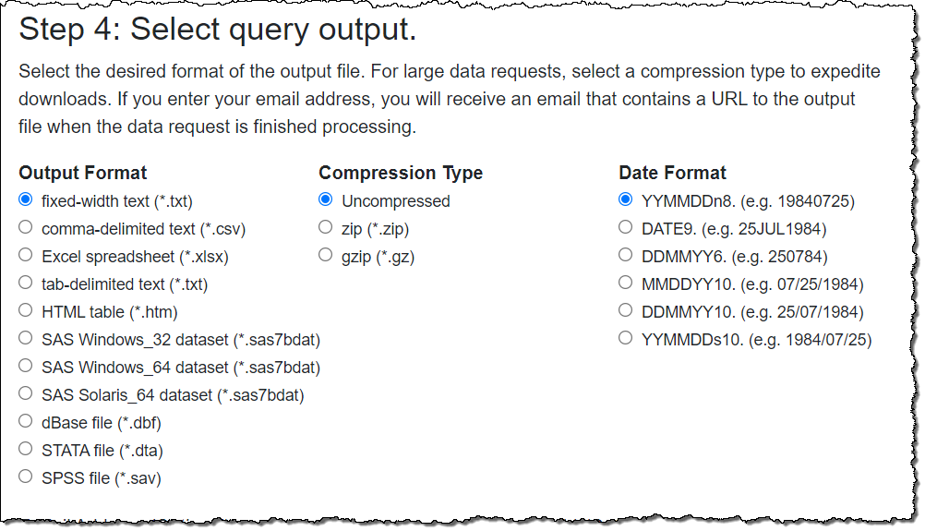
Select the Query Output Format
For this assignment, select fixed-width text (*.txt), which will display the data in your browser.

Slide 11
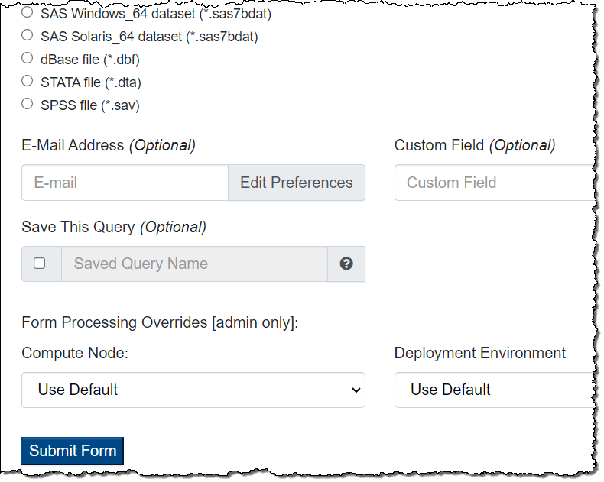
Run the Query
Click the Submit Form button at the bottom of the page to run the query.

Slide 12
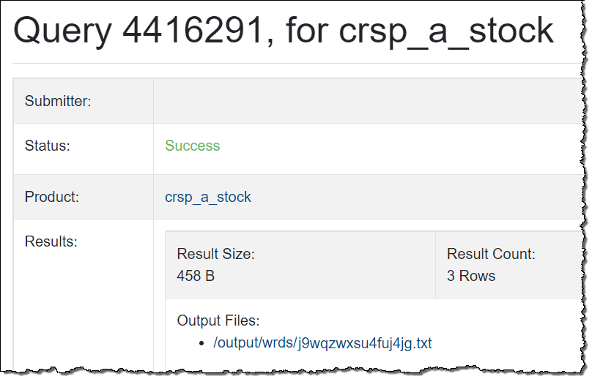
A summary page opens in a new tab, indicating the status of your query, and containing the link to your results.
“Success” means your data is ready.
Query Summary
Click the Output Files link to access the results of your query.

Slide 13
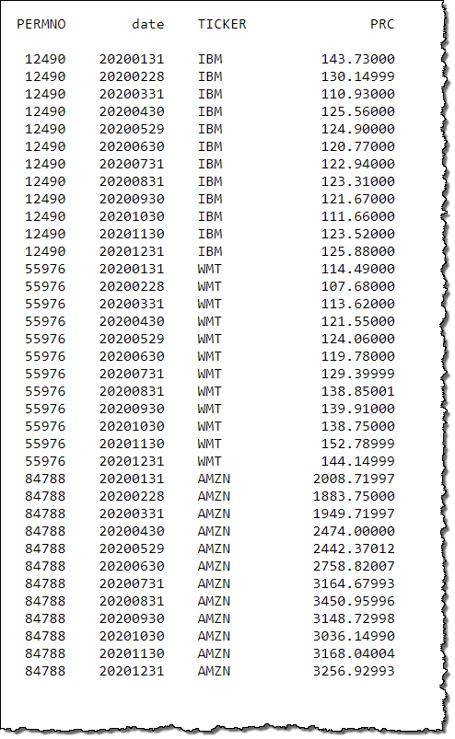
Query Results
The monthly stock prices for IBM, Amazon, and Walmart for 2020 are displayed.

Slide 14
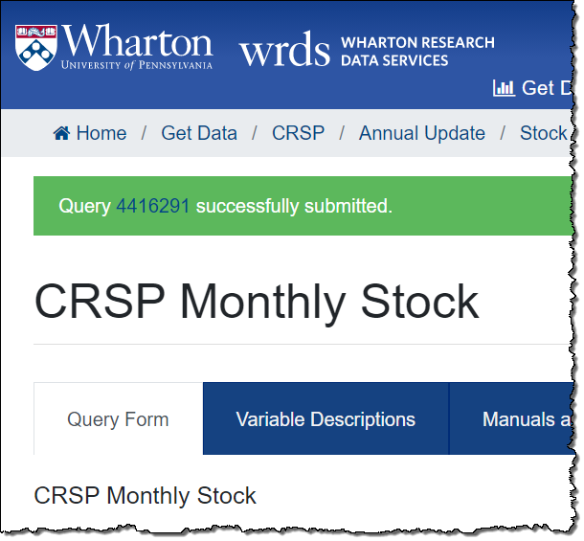
Note: Pop-Up Blocker Installed?
If you have a pop-up blocker on your browser, the query page will show a banner indicating the query was submitted.
Click the query number to proceed to the Summary screen, then click the link to access your results.

Slide 15
Stock Market Data in CRSP
• Center for Research in Security Prices (CRSP) is a research center at the Booth School of Business of the University of Chicago
•Comprehensive collection of daily and monthly security records for the NYSE/AMEX/NASDAQ/ARCA trading activities
•Daily and Monthly data for roughly 28K + securities of
Domestic companies and ADRs traded on major exchanges from 1925–present
•
Complete historical information :
Accurate records of special distributions and stock splits in return calculation
Keep delisting companies (pre-M&A or bankruptcies), and delisting returns

Slide 16
Stock Market Data in CRSP
PERMNO at security level
PERMCO at firm level
•PERMNO is a unique permanent identifier and primary key assigned by CRSP to each security: Permanent, and Unique (Not Recyclable)
•PERMCO is a unique identifier for each company assigned by CRSP: Permanent, and Unique (Not Recyclable)
•Date Identifiers
Calendar date: In monthly stock file, date is set to be the end of the month

Slide 17
Stock Market Data in CRSP
Stock Tickers: Exchange Specific, with Suffixes, NOT Permanent, and Recyclable
CRSP keeps historical changes in Ticker symbols
CUSIP also is NOT Permanent but Unique and NOT Exchange Specific.
8- or 9-digit CUSIP is assigned for issues (e.g. equities and bonds).
6-digit CUSIP is assigned for issuers (e.g. firms)
CRSP keeps both most current CUSIP and historical CUSIP (NCUSIP)
•Company Names are often abbreviated/manipulated by data vendors
CRSP keeps historical changes in company names
Very difficult to have a reliable merging code by using company names

Slide 18
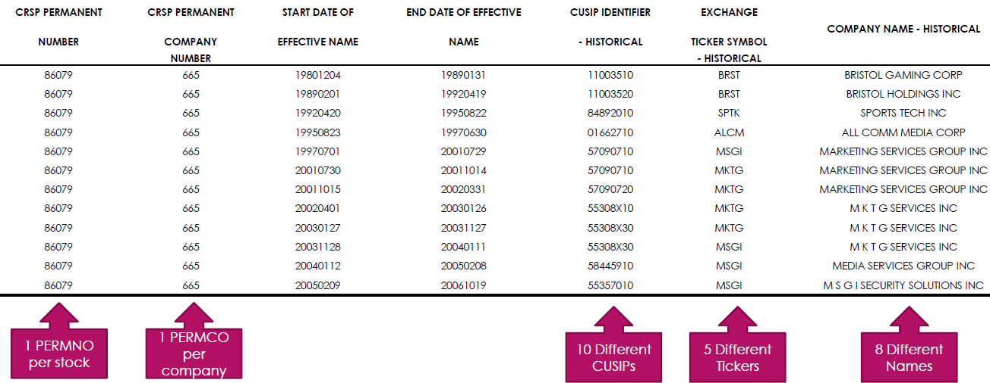
Stock Market Data in CRSP

Slide 19
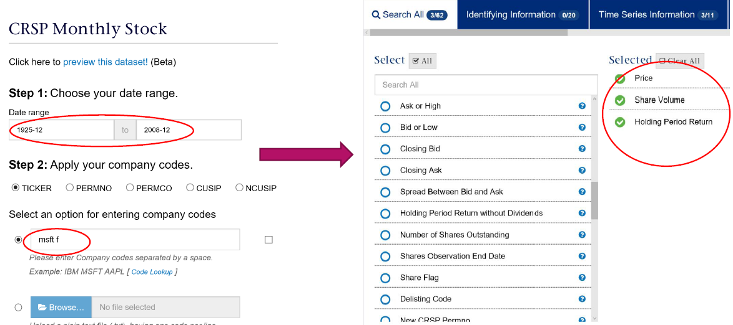
Stock Market Data in CRSP

Slide 20
Accounting and Financial Data in COMPUSTAT
• COMPUSTAT North-America: U.S. and Canadian fundamental and market information on 35,000+ active and inactive public companies, from 1950-present
• COMPUSTAT Global: Fundamental data of 39,000+ active and inactive companies in 80+ countries, the earliest data is from 1986
• Fundamental data available on an annual and quarterly frequencies with thousands of Income Statement, Balance Sheet, Statement of Cash Flows, and supplemental & industry- specific data items
• Market data available on a monthly and daily frequencies with Prices, Dividends, Returns, Trading Volume, Shares Outstanding and Short-Interest Information (Very Similar to CRSP in many dimensions)

Slide 21
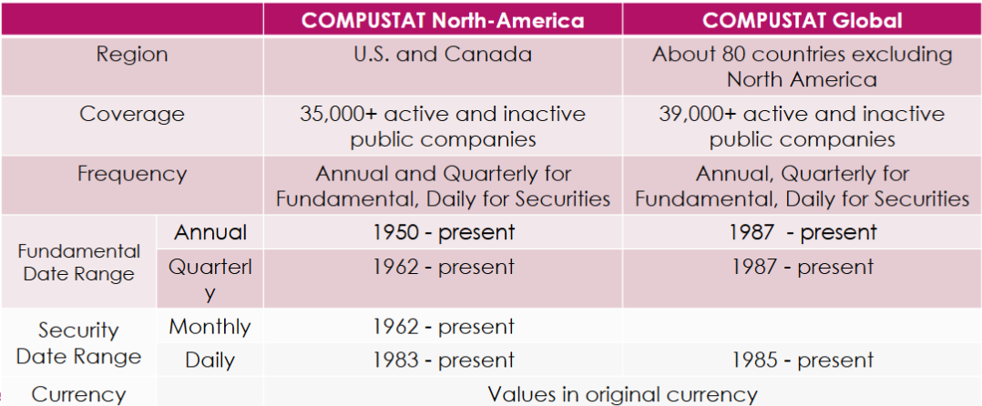
Accounting and Financial Data in COMPUSTAT

Slide 22
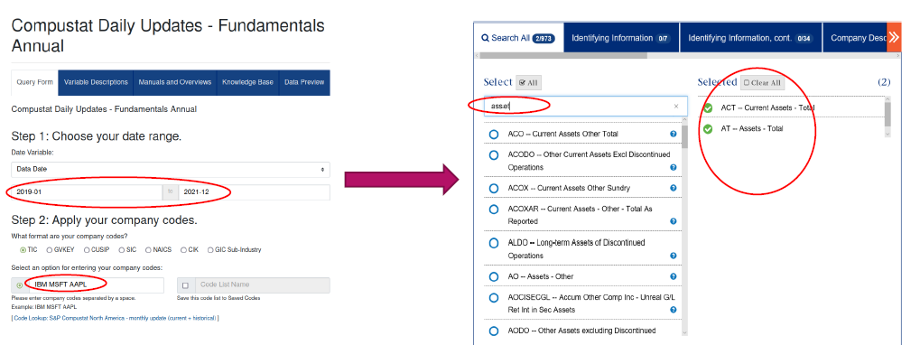
Accounting and Financial Data in COMPUSTAT

Slide 23
Accounting and Financial Data in COMPUSTAT
The Primary Identifiers
GVKEY at firm-level
GVKEY + IID at security-level
GVKEY is a unique six-digit identifier and primary key for each company and assigned by COMPUSTAT: Permanent, and Unique (Not Recyclable).
IID is assigned for each securities
Alphabet’s class A stocks: IID = 01
Alphabet’s class C stocks: IID = 03

Slide 24
Accounting and Financial Data in COMPUSTAT
Stock Tickers: Exchange Specific, with Suffixes, NOT Permanent, and Recyclable
CUSIP also is NOT Permanent but Unique and NOT Exchange Specific.
8- or 9-digit CUSIP is assigned for issues (e.g. equities and bonds).
6-digit CUSIP is assigned for issuers (e.g. firms)
CIK: US filing number at the SEC, and Changeable
Company Names are often abbreviated/manipulated by data vendors
Very difficult to have a reliable merging code by using company names

Slide 25
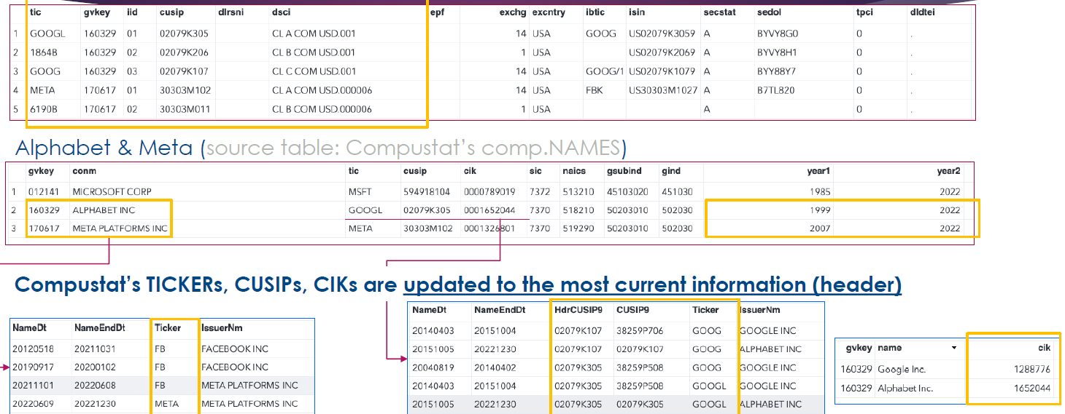
Accounting and Financial Data in COMPUSTAT

Slide 26
Accounting and Financial Data in COMPUSTAT
•Consolidation Level: Consolidated (C) / Non-Consolidated (N) / etc.
•Industry Format:Industrial (INDL) / Financial (FS)
•Data Format: Standard (STD) / Summary (SUMM_STD) / etc.
•Population Source: Domestic (D) / International (I)
•Company Status: Active (A) / Inactive (I)
•Data Items / Footnotes / Data Codes

Slide 27
Accounting and Financial Data in COMPUSTAT

Slide 28
LSEG ESG Scores
Product: | tr_esg
Library: | tresg
File: | wrds_ref_esg
Date Range: | Year (year): 2002-01-01 - 2025-05-06
Last Updated On: | 2025-05-06
Update Frequency: | Quarterly

Slide 29
LSEG ESG Scores
Detailed definitions of the variables can be found in the excel file (note that some variables are inactive):
https://wrds-www.wharton.upenn.edu/pages/get-data/lseg/refinitiv-esg/refinitiv-esg-scores/

Slide 30
Accounting and Financial Data in COMPUSTAT
Stock Tickers: Exchange Specific, with Suffixes, NOT Permanent, and Recyclable
CUSIP also is NOT Permanent but Unique and NOT Exchange Specific.
8- or 9-digit CUSIP is assigned for issues (e.g. equities and bonds).
6-digit CUSIP is assigned for issuers (e.g. firms)
CIK: US filing number at the SEC, and Changeable
Company Names are often abbreviated/manipulated by data vendors
Very difficult to have a reliable merging code by using company names

Slide 31
R programming
Clean Data
Drop funds, penny stocks
Remove duplicated rows
Drop utility and financial firms
Merge Data
CRSP & Compustat from WRDS
Identify unique key(s)
Create new variables: lead/lag, using rolling window
Create subsamples

Slide 32
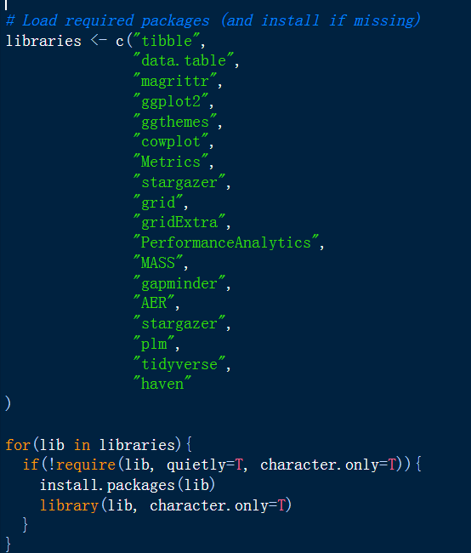
R programming

Slide 33
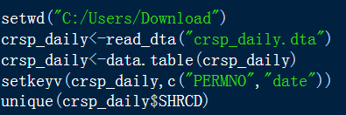
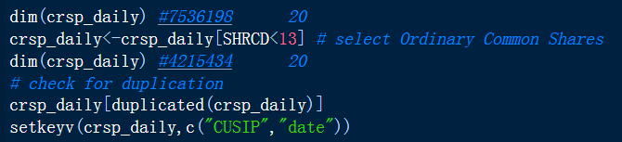
R programming
Set working directory to the folder with data
Check data size and duplication

Slide 34
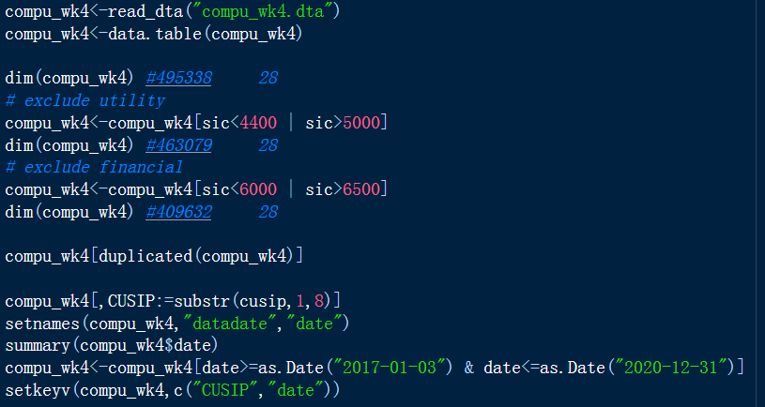
R programming
Drop utility and financial industries

Slide 35
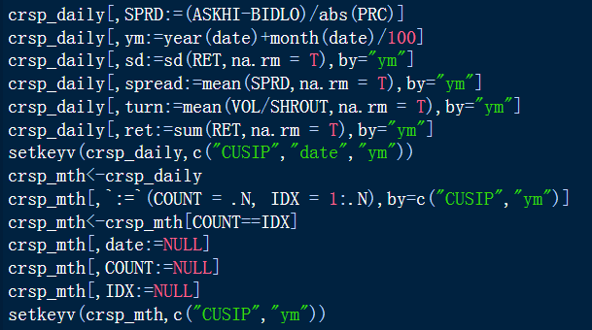
R programming
Create variable using :=
Change daily to monthly using mean() and/or sum()

Slide 36
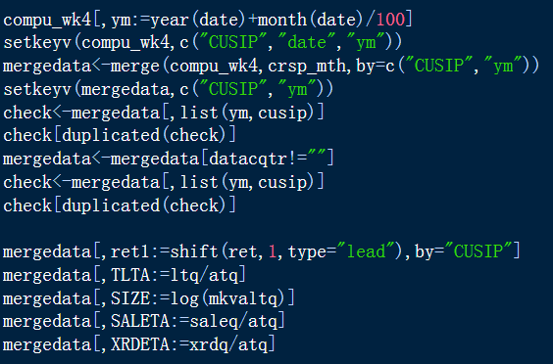
R programming
Merge by company ID and year-month

Slide 37
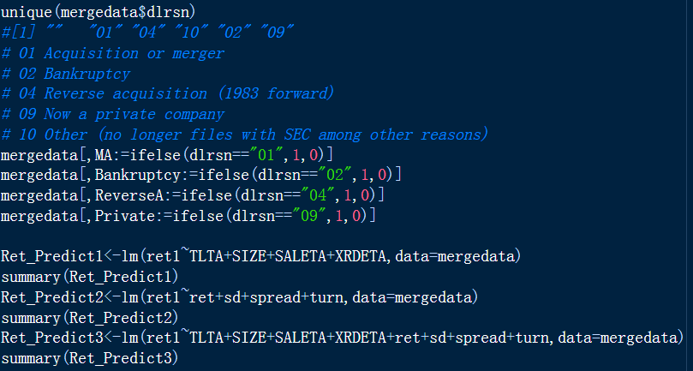
R programming
Dummy variables and linear regression

Slide 38
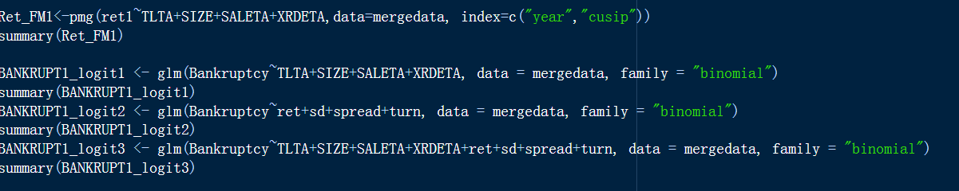
R programming
Fama-Macbeth regression
Logit regression

Slide 39
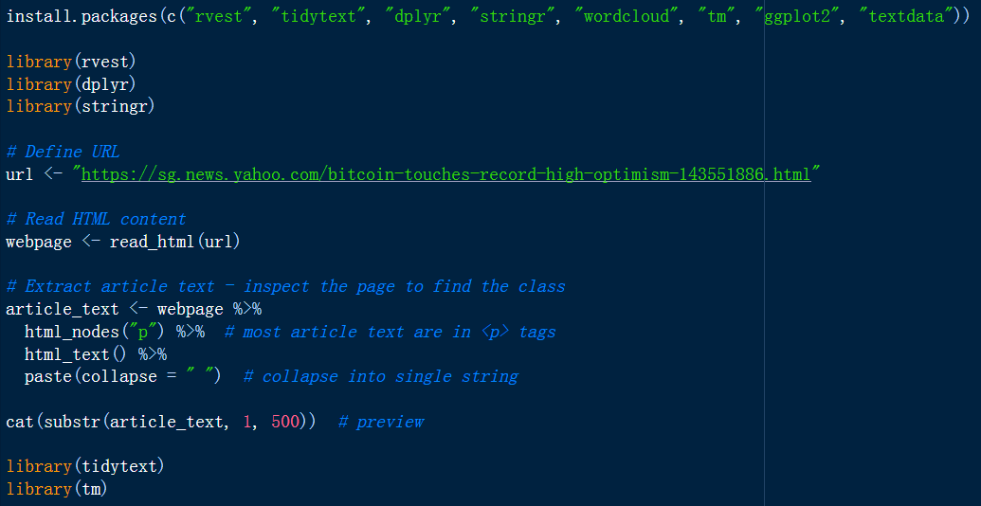
R programming
Sentiment Analysis: read an article from website

Slide 40
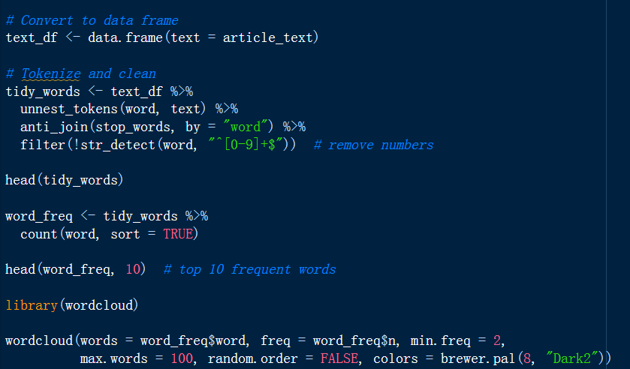
R programming
Sentiment Analysis

Slide 41

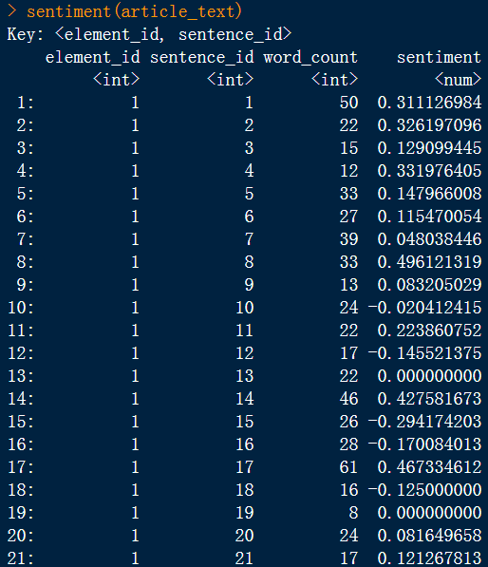
R programming
Sentiment Analysis

Slide 42
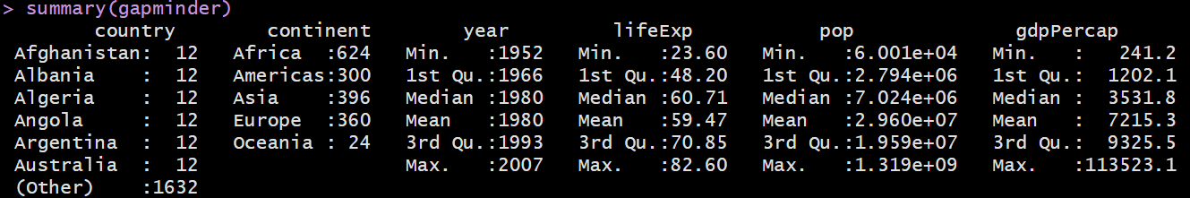
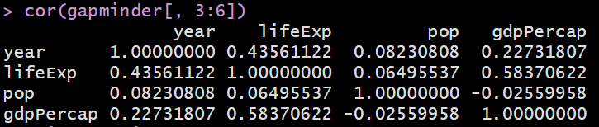
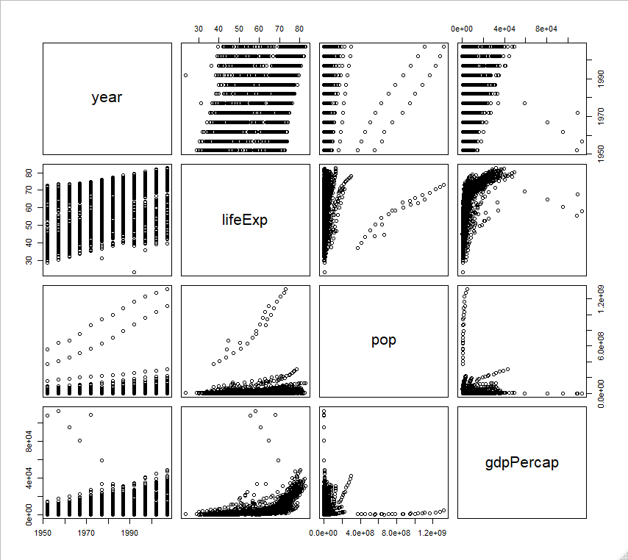
R programming

Slide 43
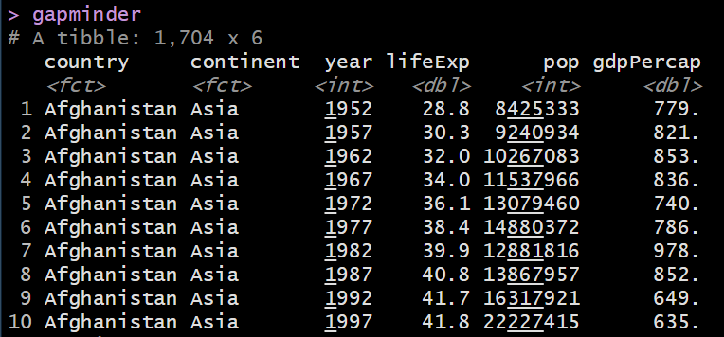
R programming
Read Global Development Metrics through gapminder library
install.packages("tibble")
library(gapminder)
gapminder # life expectancy, GDP per capita, and population by country

Slide 44
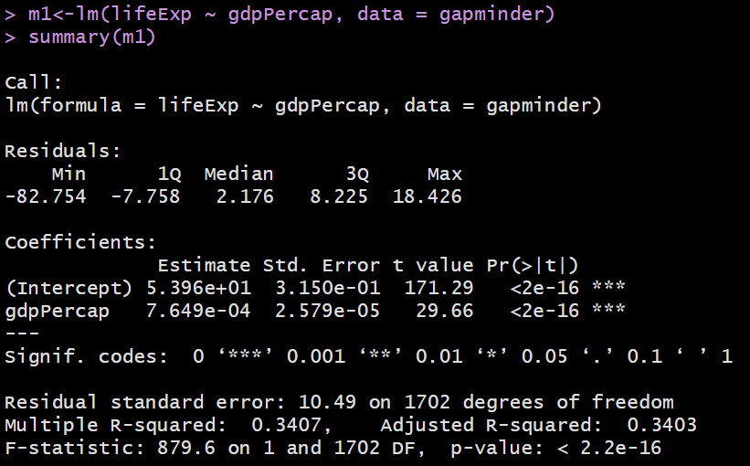
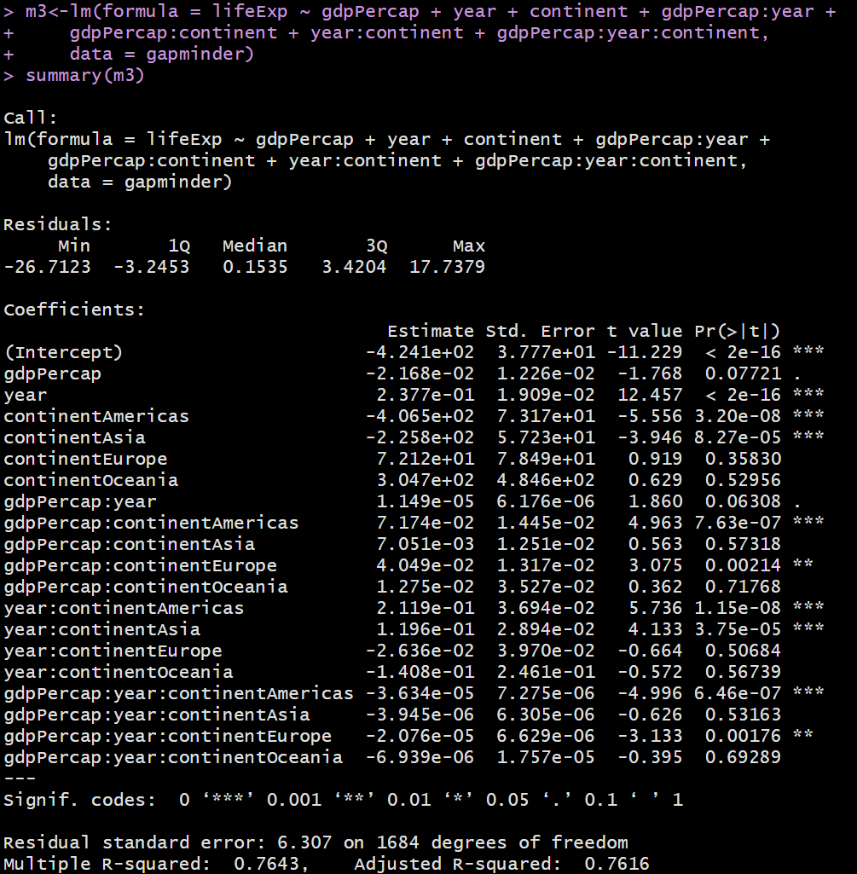
R programming

Slide 45
Case2 Cigarette Consumption Panel Data
R programming
State: Factor indicating state.
Year: Factor indicating year.
Cpi: Consumer price index.
Population: State population.
Packs: Number of packs per capita.
Income: State personal income (total, nominal).
Tax: Average state, federal and average local excise taxes for fiscal year.
Price: Average price during fiscal year, including sales tax.
Taxs: Average excise taxes for fiscal year, including sales tax.
Real per capita prices = price / cpi
Log real price = log(rprice)
Sales tax = (taxs - tax) / cpi
Log number of packs = log(packs)
Target: explain log number of packs (Y) using log real price (X)
Real price is highly correlated with sales tax, which is instrument (Z)
Solution: 2-stage regression where the second stage input is predicted X using Z
Notes:
State: Factor indicating state.
Year: Factor indicating year.
Cpi: Consumer price index.
Population: State population.
Packs: Number of packs per capita.
Income: State personal income (total, nominal).
Tax: Average state, federal and average local excise taxes for fiscal year.
Price: Average price during fiscal year, including sales tax.
Taxs: Average excise taxes for fiscal year, including sales tax.
# compute real per capita prices
CigarettesSW$rprice <- with(CigarettesSW, price / cpi)
# compute the sales tax
CigarettesSW$salestax <- with(CigarettesSW, (taxs - tax) / cpi)
# check the correlation between sales tax and price
cor(CigarettesSW$salestax, CigarettesSW$price)
#[1] 0.6141228

Slide 46
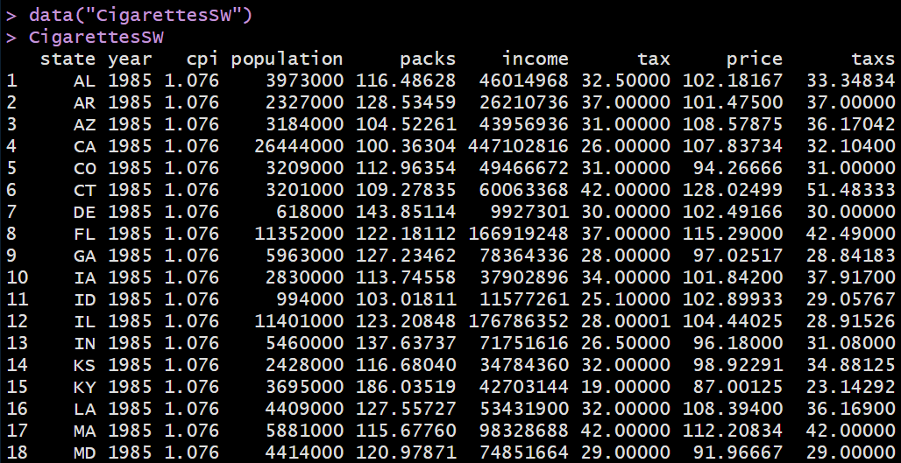
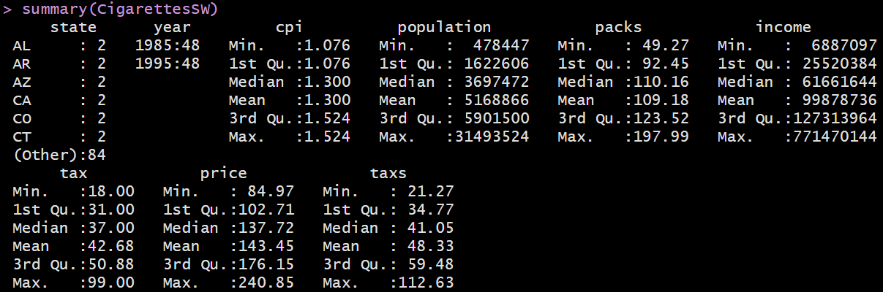
R programming

Slide 47
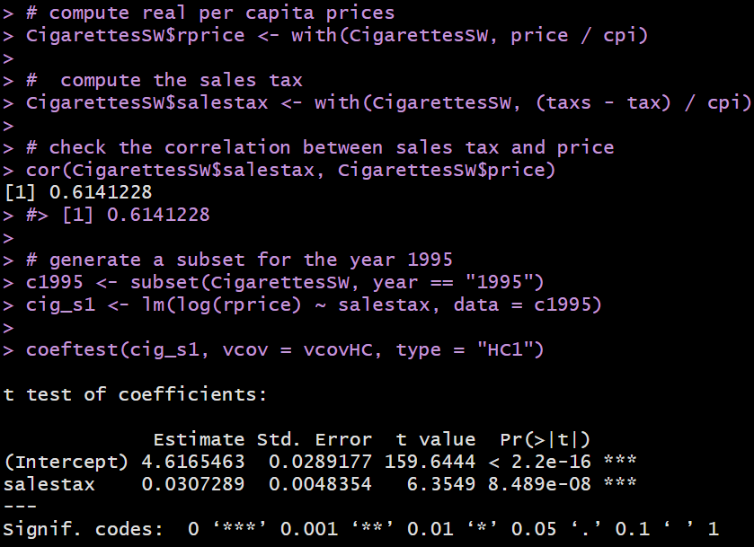
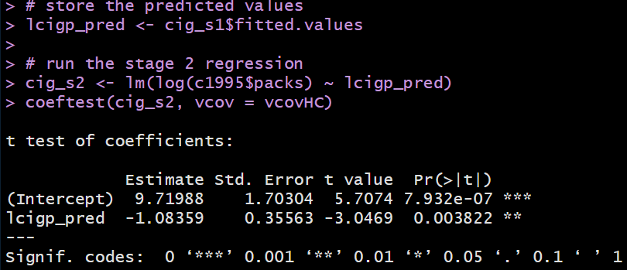
R programming
Observations & Learning:
For simplicity, we study the relationship between price and sales in year 1995 only.
Instrument relevance condition: the instrument (the real sales tax per pack) correlates with the regressor (log real per capita prices), ie high correlation between X and Z.
First stage is to run and predict X (log real per capita prices) using Z (real sales tax) as instrument
vcovHC: Heteroskedasticity-Consistent Covariance Matrix Estimation
Observations & Learning:
The predicted value of X (R code fitted.values or a+bX) in the first stage would be saved and to be used in the second stage.
Second stage is to run and predict number of packs using the predicted value from the first stage regression.

Slide 48
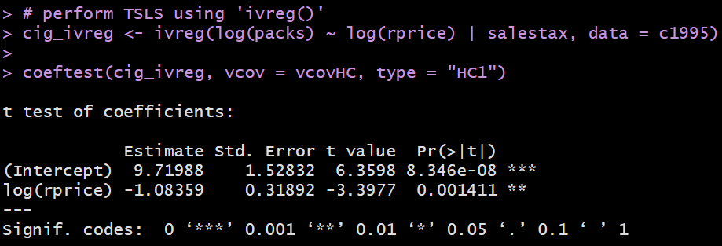
R programming
Perform IV regression (2-step in one model)
Observations & Learning:
2-stage in ivreg() where the IV salestax is included after “|”.

Slide 49
R programming
Wage: Raw wages in 1976 (in cents per hour).
Education: Education in 1976 (in years).
Experience: Years of labor market experience, computed as age - education - 6.
Ethnicity: Is the individual African-American ("afam") or not ("other")?
Smsa: Does the individual reside in a SMSA (standard metropolitan statistical area) in 1976?
South: Factor. Does the individual reside in the South in 1976?
Age: Age in 1976 (in years).
Nearcollege: Did the individual grow up near a 4-year college?
Nearcollege: Did the individual grow up near a 2-year college?
Nearcollege: Did the individual near a 4-year public or private college?
Enrolled: Is the individual enrolled in college in 1976?
Married: Is the individual married in 1976?
Education: Education in 1966 (in years).
Smsa: Does the individual reside in a SMSA in 1966?
South: Does the individual reside in the South in 1966?
Feducation: Father's educational attainment (in years). Imputed with average if missing.
Meducation: Mother's educational attainment (in years). Imputed with average if missing.
Fameducation: Ordered factor coding family education class (from 1 to 9).
Kww: Knowledge world of work (KWW) score.
Iq: Normed intelligence quotient (IQ) score
Parents: Factor coding living with parents at age 14: both parents, single mother, step parent, other
Library: Was there a library card in home at age 14?

Slide 50
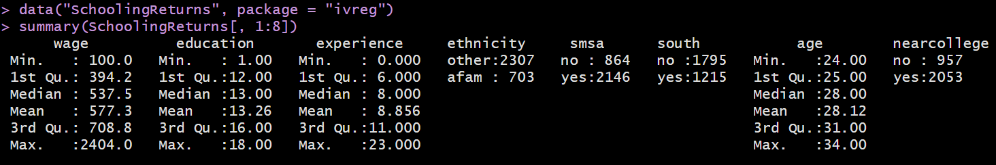
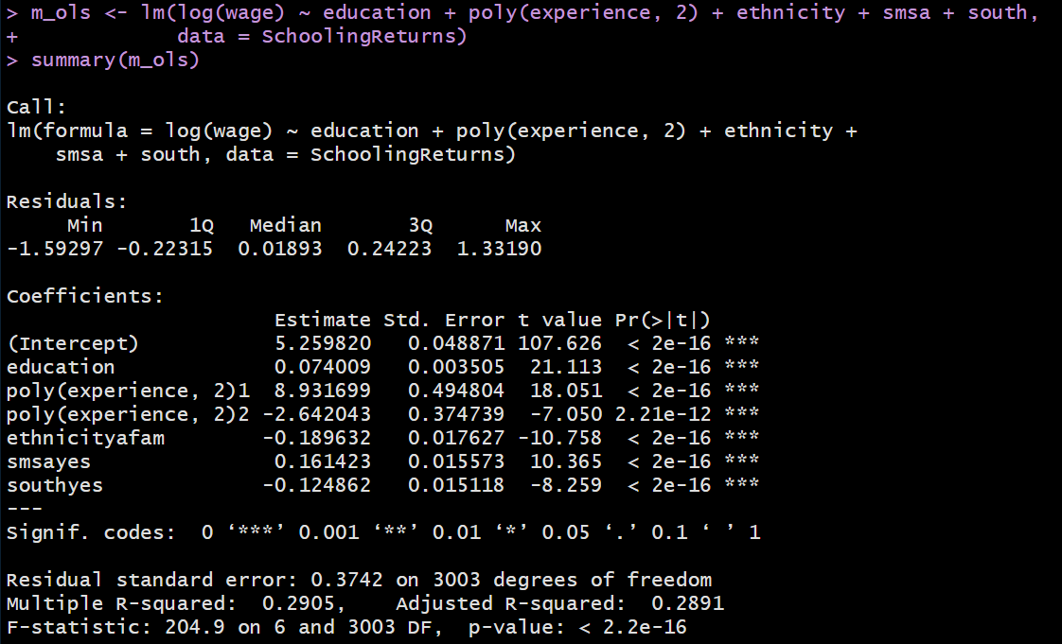
R programming
Observations & Learning:
Poly(experience, 2) is to compute 2-degree orthogonal polynomials of experience
Coefficient of education is 7%
Impact of the quadratic component of experience is statistically strong

Slide 51
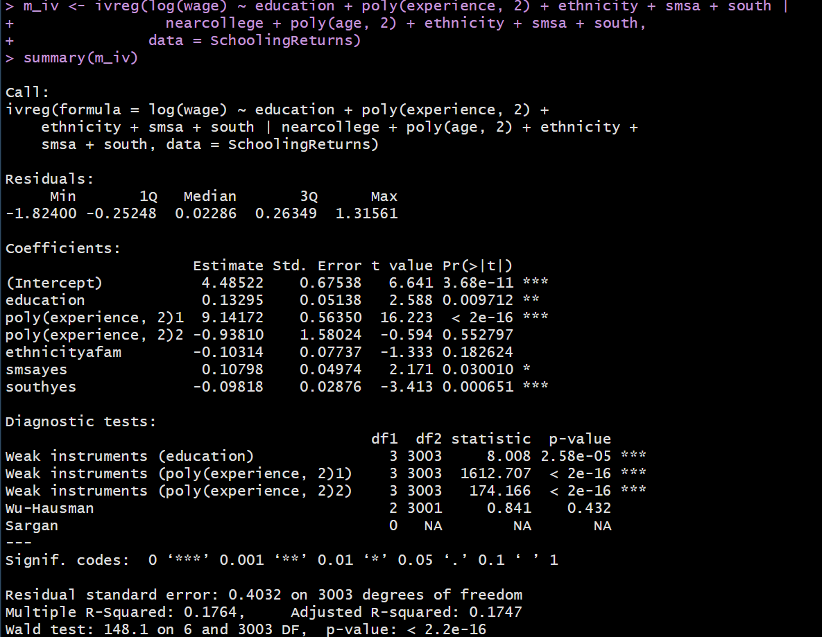
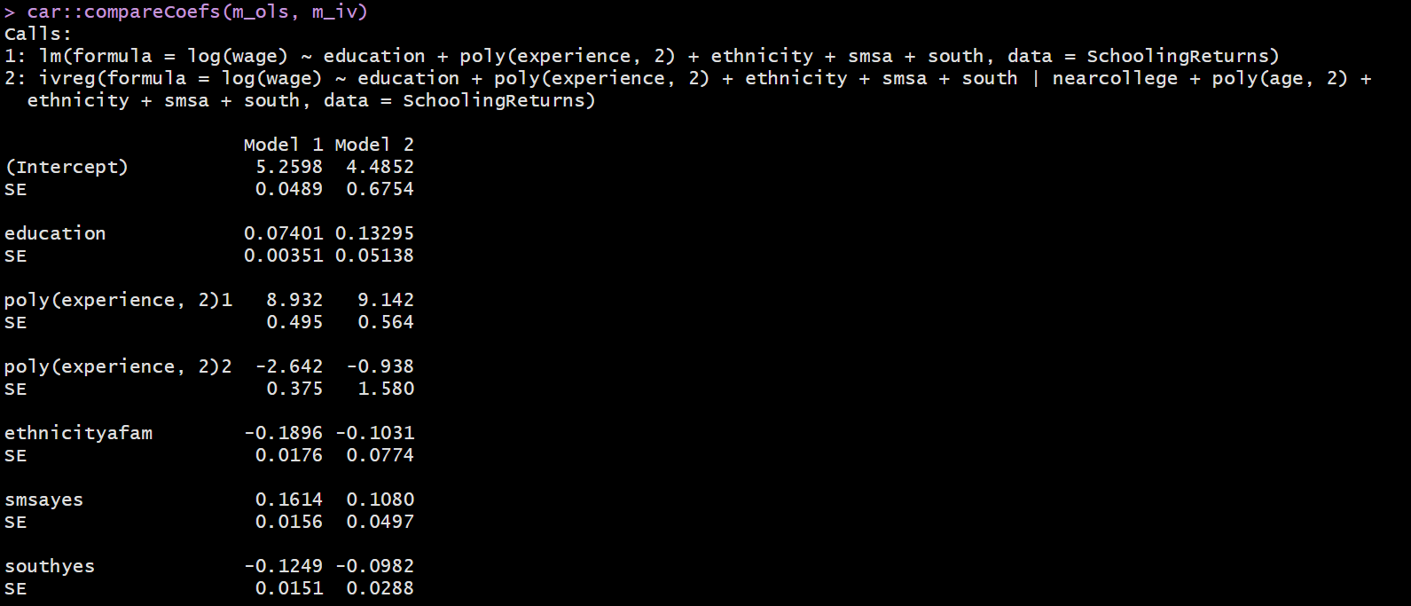
R programming
Observations & Learning:
There could be multiple Instrumental variables in the regression
Coefficient of education is 13.3% per year, which is larger than the 7%
Impact of the quadratic component of experience is weaker
Observations & Learning:
There could be multiple Instrumental variables in the regression
Coefficient of education is 13.3% per year, which is larger than the 7%
Impact of the quadratic component of experience is weaker

Slide 52
Seminar Activity
Download 10 companies’ spread, turnover and return (daily) and find the annual Spread and Turnover (mean) and RET (sum)
Download 10 companies’ SIZE (log of market capitalization), leverage (TLTA), revenue (SALETA) (annual), industry code (sic), merge data by year
Find the future return of the firm (RET1)
Find the correlation matrix including the following variables: RET1, RET, Spread, Turnover, SIZE, TLTA, SALETA and sic, and run three regression models

